Slide 1
Program of Projects Study The Impacts of Regional Transit Investment Forum March 21, 2013
Move LA - "LA's Got Lines"
Notes:
Joint collaboration between CTIB and the Metropolitan Council.
video link in case it does not work above --
http://www.youtube.com/watch?feature=player_embedded&v=TTbElIgLh8o

Slide 2
Regions Ranked by Size of Metro Economy
RANK | CITY | 2010 GROSS METRO PRODUCT
2 | Los Angeles | 737.9
5 | Houston | 378.9
6 | Dallas | 376.8
8 | San Francisco | 337.4
9 | Boston | 311.3
10 | Atlanta | 270.6
12 | Seattle | 231.4
13 | Minneapolis/St. Paul | 198.3
15 | Phoenix | 190.6
16 | San Diego | 172.2
17 | Denver | 157.1
18 | San Jose | 151.6
20 | St. Louis | 128.7
21 | Portland | 122.8
27 | Cleveland | 105.1
43 | Salt Lake | 66.5
Source: US Conference of Mayors and the Council for the New American City, U.S. Metro Economics: GMP and Employment Forecast, 2011
Notes:
Same data as previous slide, but only ranking US Cities (instead of cities and states)
Beyond competing between Minneapolis and St. Paul. Competing with other states and countries.

Slide 3
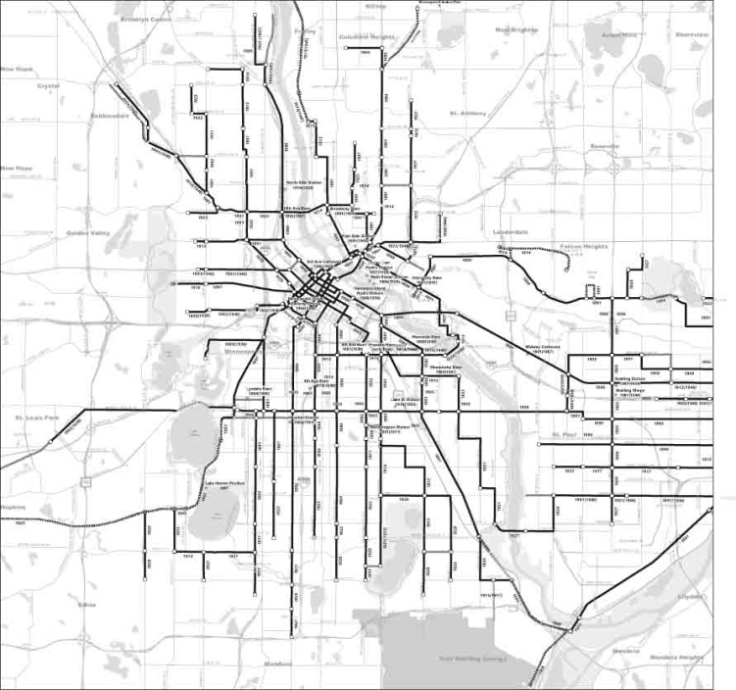
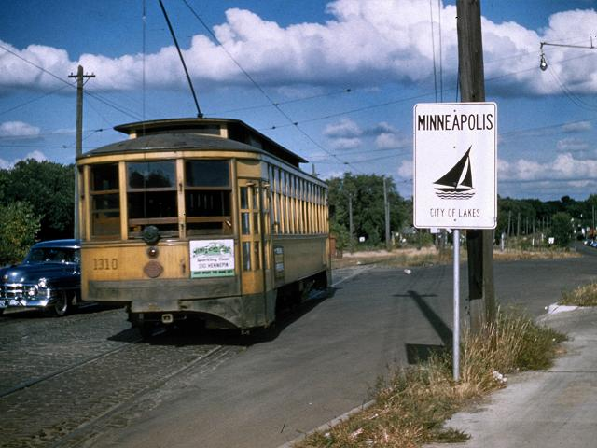
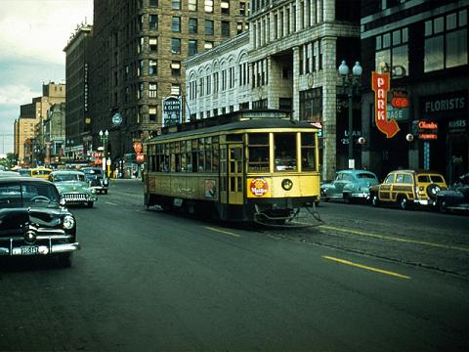
Transit Investment: Streetcars
Notes:
Pm
Huge streetcar system
>600 miles of track
Across the region
“Created” many first ring suburbs & the 20th Century Twin Cities
“Defined” development pattern after the logging/milling/railroad era
Photos above:
1909 Panoramic Map of streetcar system
Two representative photos from 1950’s – 44th & France (left) and 5th & Hennepin (right)
Middle – system as of 1950’s

Slide 4
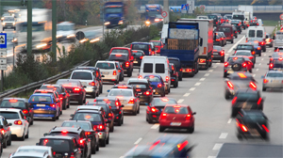
Then came freeways…

Slide 5
Expansion to the Suburbs
Notes:
Successful economy
Why was this economy competitive? Infrastructure investment
International Airport
Freeway system
K-12
Higher education
Nicollet Mall

Slide 6
The Plan: A Program of Projects
Funded by Corridors of Opportunity initiative (March 2011)
Comprehensive new approach to regional development
Accelerate the build-out of the regional transit system
.
Notes:
Corridors of Opportunity -- not just transit, not just transportation
Comprehensive approach to development and economic opportunity

Slide 7
Shared Regional Vision
Notes:
Same spine, same vision, but acknowledging scarcity

Slide 8
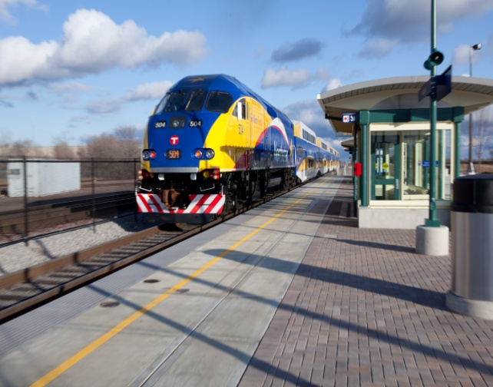
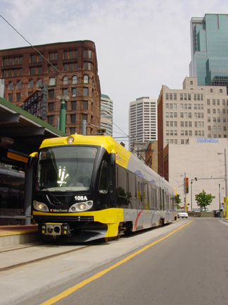
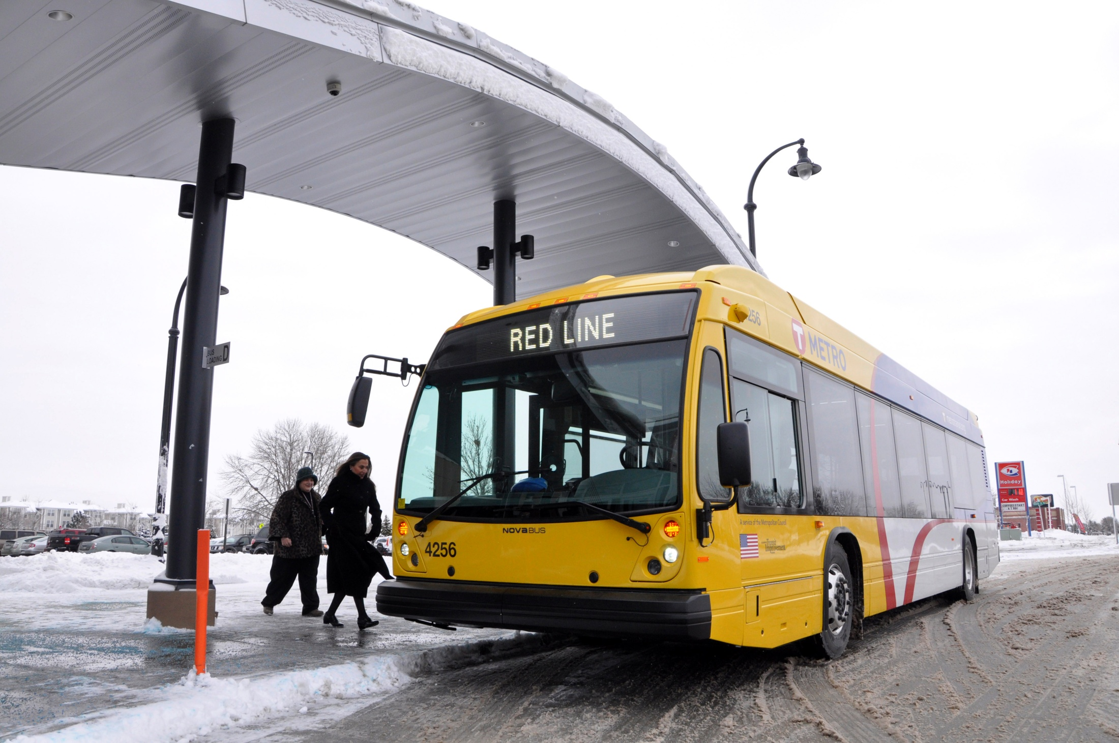
Shared Regional Vision
A regional transit system that will enhance our ability to compete in the global economy, help attract and retain jobs, connect to highways and roads, increase mobility and protect our qualify of life.
Notes:
Barbara Luckerman conversation
Leaving the auto-centric world of the last 60 years to a more balanced approach
Beyond Levittown as the controlling model

Slide 9
The Study: A Program of Projects
Components: 6 core projects
9 expansion projects (multiple modes)
Total Cost: Capital: up to $5.7 Billion
Operating Subsidy: $102 million/year
Funding Partners: Federal, State, CTIB and Local Government
Notes:
Hired HDR to assist us
Used HUD Sustainable Communities Grant

Slide 10
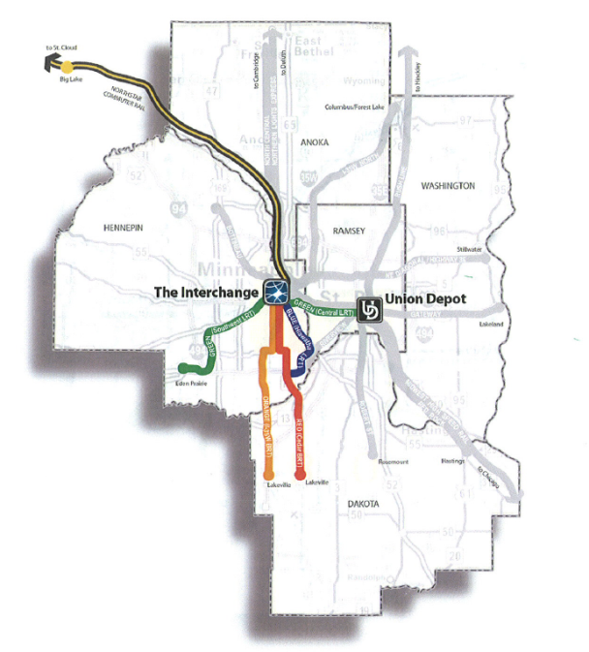
Six Core + 9 Expansion Projects
Hiawatha LRT
Northstar Commuter Rail
Cedar Avenue BRT (all phases)
Central Corridor LRT
Southwest LRT
I-35W South BRT (all phases)
Core Projects have approved alignments and modes (LPAs) and are in Preliminary Engineering , construction or operation.
Notes:
6 core projects are named in the slide.
Capital and Operating Expenses
9 Expansion projects could come from the grey unidentified corridors. 3 arterial BRTs also included in the analysis.

Slide 11
3 PoP Scenarios w/9 Expansion Projects
Mode | BRT | BRT plus 1 Rail | BRT plus 3 Rail
LRT BRT – Exclusive | None 2 projects | 1 line 1 project | 2 lines None
BRT – Highway Commuter Rail | 4 projects None | 4 projects None | 3 projects 1 line
Arterial BRT | 3 lines | 3 lines | 3 lines
Number of additional Expansion Projects | 9 | 9 | 9

Slide 12
BRT plus 3 PoP Scenario
Mode | Core Projects | Expansion Projects | Total
LRT | 3 | 2 | 5
BRT – Highway | 2 | 3 | 5
Commuter Rail | 1 | 1 | 2
Arterial BRT | 0 | 3 | 3
Total | 6 | 9 | 15
Building Blocks
12
Notes:
Funding: insufficient or uncertain funding at all levels
Resources: competing demands on limited resources
Statutory or regulatory constraints

Slide 13
Financial Analysis: Program of Projects Study
Is it possible:
To complete our shared vision given current funding practices and policy?
To build our vision more quickly given current funding practices?
Sneak peak at the answers: No
How have other cities accelerated their building?
What might work in our region? What are our options?

Slide 14
What Challenges Did We Identify?
Challenges | Federal | State | CTIB | Local
Uncertain / Insufficient Funding | ✓ | ✓ | ✓ | ✓
Competing Demands on Limited Resources | ✓ | ✓ | ✓ | ✓
Statutory or Regulatory Constraints | ✓ | ✓ | ✓ | ✓
14
Notes:
RRAs: over half a billion dollars in property taxes through 2030 at 10% share
Met Council 2030 plan couldn’t be built with current resources

Slide 15
How have Peer Regions Addressed Funding Challenges?
Capital funding sources?
Financing tools?
Project delivery methods?
Operations and maintenance funding?
Innovative approaches to fast tracking projects?

Slide 16
Peer Regions Summary
City | Program | Total Program Cost | Base Sales Tax | Sales Tax Increase | Total Sales Tax | Modes | Capital vs O&M | State Funding
Dallas | DART Rail Expansion | $1.6 billion | 1 cent | No, bonding only | 1 cent | Transit only | Both | No
Denver | FasTracks | $6.8 billion | 0.6 cent | 0.4 cent | 1 cent | Transit only | Both | Yes
Houston | METRO Solutions | $6 billion | 1 cent | No, bonding only | 1 cent | Transit only | Both | No
Los Angeles | LA 30/10 Initiative | $17.5 billion | 0.0 cent | 1.5 cent | 1.5 cent | Transit and roadway projects | Both | Yes
Phoenix | Future High Speed Transit Corridors | $3 billion | 0.5 cent Tempe 0.4 cent Phoenix | 0.5 cent regional | 1.0 & 0.9 cent respect-ively | Cities for transit only Regional for transit and roadways | Cities Both Regional for rail capital Regional for bus capital and O&M | No
Seattle | ST2 | $17.8 billion | 0.4 cent | 0.5 cent | 0.9 cent | Transit only | Both | No
Salt Lake | FrontLines 2015 | $2.3 billion | 0.50 cent | 0.25 cent | 0.75 cent | Transit only | Both | No
Notes:
Included to help demonstrate depth of anlaysis. Peer cities are:
Dallas
Denver
Houston
Los Angeles
Phoenix
Seattle
Salt Lake

Slide 17
Peer Cities Findings
All cities defined and developed a specific program of projects.
All cities use sales taxes as the primary local funding source.
All cities use sales taxes for transit and transitway capital and operations.
All cities use FTA New Starts funding
Several of the cities are implementing projects using all non-federal funds.
Most of the cities had to raise their sales tax rate to fund a Program of Projects.
Only two of the seven cities receive state funding.

Slide 18
Conclusions for the Twin Cities
Peer Regions use dedicated sales tax revenue as primary non-federal funding source
Innovative financing is used on the margin, if at all (value added, P3s, etc.)
Current Twin Cities’ dedicated sales tax of 0.25% is insufficient

Slide 19
Sales Tax as a financial building block
New Revenue Generated
0.25% additional sales tax
Additional $100 million/year
0.50% additional sales tax
Additional $200 million/year
0.75% additional sales tax
Additional $300 million/year
equals $20M/year or .05%. Collection assumed through 2040.
Notes:
Ending in 2040 --- ultimately an arbitrary deadline
Greater capacity if used to retire some portion of bonds after 2040

Slide 20
PoP Building Blocks
37.5% Federal share - LRT .08%
0% State share - PoP capital .14%
0% State share - PoP operation .16%
Unfunded CTIB share of PoP .10%
0% RRA share - PoP capital .10%
Addn’l. tax needed 12 blocks .58%
$232,000,000/yr
NOTE: Sales tax rates are estimates and have been rounded.
Sales tax rate
Notes:
Wide variety of options to address funding partner constraints related to an accelerated Program of Projects.
Addressing of all these challenges would take more than a half cent of new sales tax revenue.

Slide 21
Other Building Blocks
Sales tax rate
State $70M bus op. approp. .18%
State share of bus expansion
Capital .03%
Operations .11%
State capital & op. share of 9
more arterial BRT (12) .16%
Addn’l. tax needed 9+ blocks 0.48%.
$198,000,000/yr
NOTE: Sales tax rates are estimates and have been rounded.
Notes:
Stabilization of the system
In addition, our regional transit system faces other challenges, such as expanding the base bus system to meet population growth and increased ridership.
We looked at a variety of options for addressing other transit challenges. Combined

Slide 22
Prioritize
System Expansion/ System Stabilization
Elements
State share – capital, new and existing
State share – operating
RRA share – capital
Commuter rail – No
Bus expansion: regular route & arterial BRT
Federal share
Use of Financing
Notes:
Solved with sales tax only ---
Can’t build a system that will attract riders without expansion into high quality modes

Slide 23
Next Steps: Program of Projects
Support Governor’s ½-cent increase in transit tax for expansion of transit and stabilization of operations
Continue work with FTA:
MAP-21 includes POP provisions
Policy guidance expected to be issued this summer
Develop scenarios for the POP build out
Back to #1: Get the money!!!!!

Slide 24
Thank You
Commissioner Peter McLaughlin, Chair
Counties Transit Improvement Board
www.mnrides.org
peter.mclaughlin@co.hennepin.mn.us

