Slide 1
Regional Transit System:
Return on Investment Assessment
March 2013
Notes:
0

Slide 2
Today’s agenda
  Itasca Project introduction
  Transit ROI objectives
  Results of analysis
  Comments from business leaders
  Conclusion
1
1 Footnote
SOURCE: Source

Slide 3
Itasca Project introduction
What is Itasca?
An employer-led civic alliance focused on:
  Building a thriving economy and quality of life in the Minneapolis-Saint Paul Metropolitan region
  Reducing and eliminating socioeconomic disparities
Who is Itasca?
50-plus cross-sector community leaders from Minneapolis-Saint Paul:
  Private sector CEOs
  Public sector leaders: the Governor, the Mayors of Minneapolis and St. Paul, Chair of the Metropolitan Council, the leaders of the University of Minnesota and MnSCU
  Leaders of major foundations and United Way

Slide 4
Itasca Project priorities
1
Generating high-quality job growth
Itasca project goals
Raise economic competitiveness
and quality of life
Reduce and
eliminate
disparities
2
3
Advancing a comprehensive and aligned transportation system
Improving our region’s education system

Slide 5
The transportation system impacts the economic health and vitality of a region…
A comprehensive, integrated, and efficient transportation system is an important driver of economic development and, therefore, job growth because it…
Connects employers to their workforce and enables employees to access employment; connects businesses to customers; maintains timely movement of goods
Attracts and retains residents by providing greater diversity of travel options, including more free-flowing roads and affordable transit options
Enables strategic, efficient investment in long-term infrastructure, e.g., energy grid, water system, housing, commercial and industrial buildings
When employers examine where to locate, strong transportation infrastructure is one of the top 3 considerations, along with workforce quality
Notes:
4
The task force spent several months reviewing statistics and studies and considering ideas – then aligned around four strategic priorities to drive long-term prosperity
– 1) Align academic offerings with workforce needs
– 2) Foster an ecosystem of research and innovation
– 3) Form new collaborations across higher ed. to optimize system-wide intellectual assets and efficiency
– 4) Graduate more students

Slide 6
…Transit is increasingly critical to sustaining the economic vitality of our region
  In Minnesota, transit plays a vital role in connecting jobs and employees today...
      40% of downtown Minneapolis and St. Paul commuters use transit
      According to MetCouncil, transit riders are more than 1/3 of peak hour users of major freeways
  ...and will become more important in the future
      Building out full transit system would give regional employers access to an additional half a million people within half an hour commute
      Increasingly, talented millennial generation employees are seeking cities with good transit
  Transit can be a cost-efficient way to add capacity in corridors, improving travel times across the system especially during peak congestion periods
  Competitor regions are investing heavily in transit; these regions include Denver, Salt Lake City and Dallas, all rapidly growing, dynamic regions
Notes:
5
The task force spent several months reviewing statistics and studies and considering ideas – then aligned around four strategic priorities to drive long-term prosperity
– 1) Align academic offerings with workforce needs
– 2) Foster an ecosystem of research and innovation
– 3) Form new collaborations across higher ed. to optimize system-wide intellectual assets and efficiency
– 4) Graduate more students

Slide 7
Transit ROI study
Objective: Evaluate potential transit impacts to the region using data-driven and transparent approach
Commissioned by Itasca
Conducted by Cambridge Systematics, experts in transportation and economic analysis
Guided by local Technical Advisory Committee
6

Slide 8
Itasca asked 3 questions about regional transit investments
1
  A built-out regional transit system would require substantial investment. What would be the return on that investment?
  Investments can be made more or less quickly. Would accelerating build out change the return on investment?
  Many communities with developing transit systems experience more growth near transit stations. Would such expectations for growth change the return on investment?
2
3
7

Slide 9
We compared four scenarios
Base case
  Includes current transit options and assumes outstanding commitments are built out (including Central Corridor)
2030 regional
plan
  Assumes Metropolitan Council 2030 plan is executed, including expansion of bus service at 1% annually, nine arterial BRTs, four completed BRT corridors, and three new LRT lines
1
Accelerated
regional plan
  Accelerates the regional plan from scenario one to a 2023 completion
2
2030 plan with
growth
near stations
  Proposes 2030 plan is built as in scenario one, but reallocates 25% of expected community growth to station areas (i.e., assumes station areas absorb more of future growth though does not presume new growth)
3
8

Slide 10
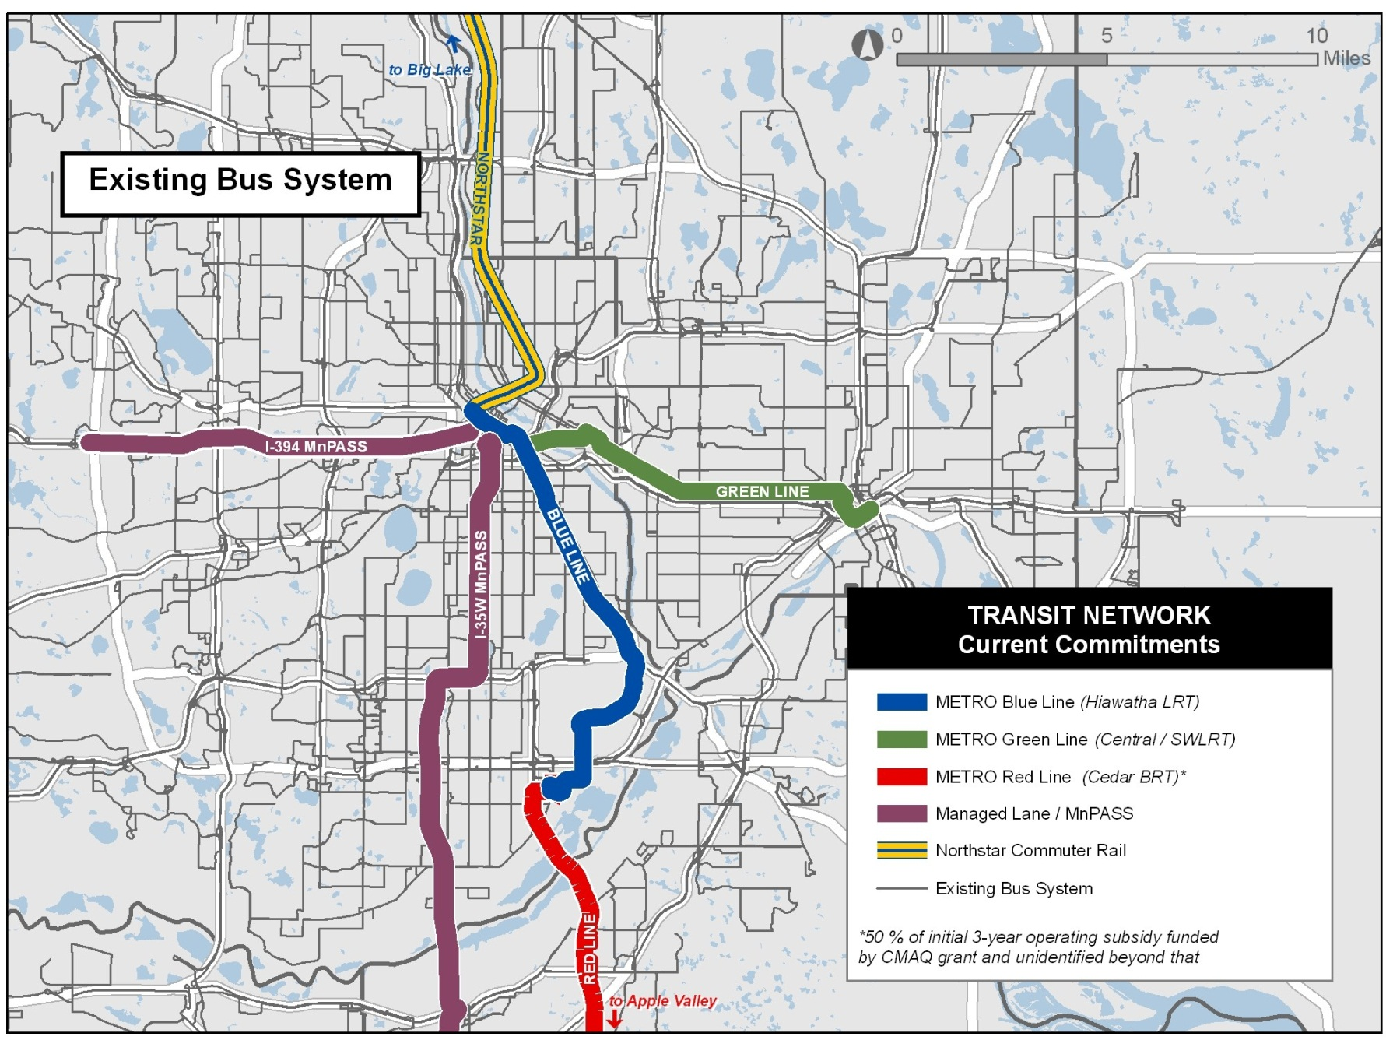
Current Regional Transit System Commitments
9

Slide 11
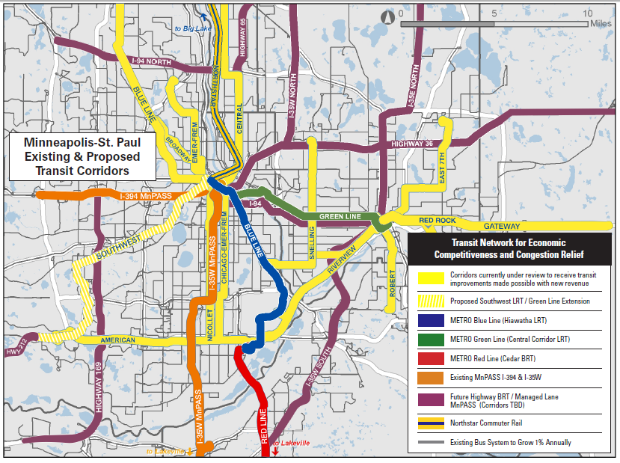
Proposed Regional Transit System – 2030
A regional transit system in the Minneapolis – St. Paul Metro area includes:
  1% per year bus service expansion
  Addition of nine arterial BRTs
  Four BRT lines
  Total of five LRT lines
  Mode and alignment for each corridor are still being determined
10
Source: The Twin Cities Metropolitan Council's 2030 Transitway Plan featuring commuter rail, light rail, bus rapid transit and improved bus corridors.

Slide 12
We calculated six kinds of direct impacts
  A few well-established metrics focused on transportation, safety, and health were incorporated as direct impacts:
  Vehicle operating costs
  Travel times and travel reliability
  Shippers and logistics costs
  Emissions
  Safety costs
  Road pavement conditions
We worked with the Metropolitan Council to develop costs for each scenario: capital + operations & maintenance
11
Notes:
11

Slide 13
Direct Impacts – Results
Compared to base case scenario
2010 $ Millions
Total direct impacts
Scenario
Investment
Low
High
IRR*
1
  2030 Regional Plan
  $4,361
  $6,571
  $10,083
  7.8 – 14.8%
2
  Accelerated Regional Plan
  $5,289
  $10,762
  $16,516
  11.2 – 18.0%
3
  2030 Plan with growth near stations
  $4,361
  $9,082
  $13,927
  13.0 – 20.9%
Note: Benefits and operating and maintenance costs are calculated for 15-year period 2030-2045 for regional system, 2023-2045 for accelerated system. All are reported in 2010 dollar
*IRR = Internal Rate of Return, the discount rate often used in capital budgeting that makes the net present value of all cash flows from a particular project equal to zero
12

Slide 14
Direct impacts by category
Compared to base case 2010 $ Millions
  Travel time savings and reliability
  Vehicle operating cost savings
  Shipper and logistics cost savings
  Reduction in emissions
  Safety benefits
  Pavement maintenance savings
  TOTAL
  $4,643 - $11,429
  $1,479 - $4,717
  $185 - $271
  $185 - $395
  $53 - $88
  $26 - $54
  $6,571 - $16,516
Note: Benefits and operating and maintenance costs are calculated for 15-year period 2030-2045 for regional system or 2023-2045 for accelerated scenario. All are reported in 2010 dollars
13

Slide 15
A regional transit system enables employers to access more potential employees
Working-age population accessible to employers within 30 minute commute (Millions)
In year 2030
In year 2045
+25%
+22%
Base Case
With transit build-out*
Base Case
With transit build-out*
Building the regional transit system would enable employers in the region to access 500,000 more employees within a 30 minute commute, a 22 – 25% increase
* With build-out of the 2030 regional plan
14
Notes:
14

Slide 16
Additional impact not considered in the ROI study results:
Short-term economic impacts:
  $4.3 billion in construction impacts – Economic activity created over the construction period
  30,000 construction jobs – FTE job-years tied to build-out of the transit system
If Federal dollars are leveraged for investments, then the ROI of state/local dollars would be even higher
Experience with Hiawatha and Central Corridor suggest Scenario 3, with the highest benefits, is a likely scenario
  2 million square feet of office space was constructed within half a mile of Hiawatha from 2004-2010
  Development of new housing exceeded 2020 projections by nearly 50% within first year of operation
  $1.2B of construction has been approved along Central Corridor, set to open in 2014
SOURCE: MetCouncil, U of MN Transitways Impact Research Program
15

Slide 17

In addition to the quantitative analysis, we interviewed regional businesses about how they view transit
Transit is important to employers’ ability to attract employees
“Improved transit provides greater efficiency to attract employees, enables them to connect with labor groups.”
“Our younger workers show a higher level of interest in transit.”
“60% of our downtown employees have a Metropass. We want to support that.”
“Transit comes up in every HR conversation with new employees.”
“Transit is important to attracting workers. Without it, working downtown would be very difficult.”
“We have a company priority to be green and socially-responsible. Supporting transit is important. We find that it gets a very positive reaction within our younger employees.”
“We worry about future commuting costs, as gas could be significantly more expensive.”
Source: Focus groups with HR and facilities leaders from leading companies in Minneapolis-St. Paul Metro area. Interviewed companies include: Target, UnitedHealth, US Bancorp, Xcel Energy, and Plymouth/Center National Bank.
16

Slide 18

What business leaders say (cont)…
Transit enables higher density development and greater customer access
Transit must be connected to and aligned with destinations and other modes of transit
“Improved transit would allow higher densities and greater customer access.”
  “Pedestrian access is important to support transit, complete last mile connections.”
  “Want to see more suburb-to-suburb connections.”
  “Higher densities encourage entrepreneurial activities.”
  “I appreciates the LRT connection to the airport but there are limited door-to-door mass transit options.”
  “Must be reliable.”
Source: Focus groups with HR and facilities leaders from leading companies in Minneapolis-St. Paul Metro area. Interviewed companies include: Target, UnitedHealth, US Bancorp, Xcel Energy, and Plymouth/Center National Bank.
17

Slide 19
Summary
  Based on direct impacts alone, the benefits of implementing a regional transit system far outweigh the costs
    Building the 2030 regional plan would result in $6.6 – 10.1 billion in direct benefits, on a $4.4 billion investment (between 2030 – 2045)
    Accelerating the system buildout to 2023 would result in increased direct benefits: $10.7 – 16.5 billion on a $5.3 billion investment
    More community growth near transit stations would also increase the return on investment by an additional $2 - $4 billion
  In addition to the quantified direct benefits, the region would benefit from many wider economic benefits
    Increased access to employers (an additional 500,000 within 30-minute commute)
    30,000 construction jobs and $4.3 billion in economic impacts
  Interviewed employers reinforced the benefits of a regional transit system
    A comprehensive transit system is critical to attract and retain employees
18

Slide 20
Appendix
19

Slide 21
Methodology and key assumptions
  The analysis estimates future benefits arising from transportation system user benefits, sustainability benefits, state-of-good repair benefits and wider economic development benefits
  Utilizes output from Metropolitan Council’s regional travel demand model; population estimates based on Met Council
  Discount rate is 2.8 percent, as recommended by MnDOT
  The SW Corridor is assumed to commence operation in 2018; for regional assessment, all corridors are assumed to operational in 2030 and impacts from 2030-2045 are estimated and reported
  The price of fuel used in the travel demand and mode choice models is $3.41 per gallon ($2.59 in 2000$ based on the CPI) to reflect the average cost of fuel in the region on October 26, 2011
20

Slide 22
Thank you to Itasca Project Transportation Task Force
Jay Cowles, Chair | Unity Ave
Mike Erlandson | SUPERVALU
David Freed | Xcel Energy
Restor Johnson | UnitedHealth
Richard Murphy | Murphy Warehouse
Judi Nevonen | US Bancorp
Duane Ring | Century Link
Lee Sheehy | McKnight Foundation
David Sparby | Xcel Energy
John Stanoch
Richard Varda | Target
Charlie Zelle, Chair | Jefferson Lines
Itasca Project leadership
Mary Brainerd, Chair | HealthPartners
Richard Davis, Vice-Chair | US Bancorp
21

Slide 23
Thank you to Technical Advisory Committee
Mary Richardson | CTIB
Mary Kay Baily | Corridors of Opportunity
Katie Walker | Hennepin County
David Lawless | Hennepin County
Lee Sheehy | McKnight Foundation
Eric Muschler | McKnight Foundation
Arlene McCarthy | Metropolitan Council
Guy Peterson | Metropolitan Council
Mark Filipi | Metropolitan Council
John Kari | Metropolitan Council
Will Schroeer | Minneapolis Regional Chamber of Commerce and Saint Paul Area Chamber of Commerce
Jim Erkel | Minnesota Center for Environmental Advocacy
Kate Johansen | Minnesota Chamber of Commerce
David Levinson | University of Minnesota
Laurie McGinnis | University of Minnesota
Caren Dewar | ULI MN and Regional Council of Mayors
Ted Schnoenecker | Washington County
22

Slide 24
Breakdown of net benefits (2030 system built out example)
Quantified benefits of transit investment
$B
6.6-10.1
Other: Includes safety, emissions, logistics and state-of-good-repair savings
Not included in benefits:
  Induced development
  Qualitative benefits (e.g., enjoyment of driving, lowered stress from not driving)
  Livability benefits, e.g., cost of housing, walkability, social capital
  Clustering benefits, e.g., more efficient use of public infrastructure, increased productivity
Other
~.45
Vehicle operating expense savings
Vehicle operating expense savings
These savings are driven by fuel expense avoided by both transit users and drivers, whose fuel use decreases with less congestion. Savings are net of transit fares.
1.5-2.6
Reliability savings
Reliability savings: Opportunity cost of the “time buffer” travelers build in during congested peaks to arrive on time, and the cost to businesses of missing on-time deliveries.
1.7-2.7
Travel time savings: As the saying goes, time is money. These savings place a value on the time saved by both transit uses, who have shorter, more direct trips with a built-out system, and the time saved by drivers, who face less congestion on roads due to transit users, and by businesses, who can ship goods and services more efficiently.
Travel time savings
2.9-4.3
Benefits

Slide 25
Travel time savings are calculated by type – personal and business
Quantified benefits of transit investment
$B
Benefit description¹
Calculation
Examples
  Includes all personal trips, including commutes, journeys to school, errands
  Does not include leisure trips
  Based on opportunity costs
  50% of the regional average wage rate¹, e.g., an hour saved in a region with a $20/hr wage rate is worth $10¹
    Values ranged from 13.93 – 20.67/hour
  Estimated daily, and then multiplied by 260 working days to arrive at annual savings
  A parent arrives home 15 minutes earlier, and pays a babysitter less
  A commuter has time to make herself breakfast in the morning, and saves a trip to the deli
  A couple has extra time at night to search travel websites, and saves $100 on their next vacation
6.6-10.1
~.45
1.5-2.6
1.7-2.7
Travel time savings
  All business-generated trips, including visits to clients, movement of goods, services
  Estimated out-of-pocket expense per unit output, includes wages for truck drivers, inventory costs
    Values ranged from $17.51-$58.57/hour
  Estimated daily and multiplied by 365 for annual savings
  A shipping company pays less overtime to its truck drivers
  A corner store is able to increase deliveries to 3 times a week, freeing up shelf space from inventory and increasing sales
Personal
2.6-3.8
Business
0.3-0.5
Benefits
1These are net benefits, that is, the generally higher travel times of transit users are subtracted from the lower travel times of highway users
2 These values were drawn from MNDOT, the Bureau of Labor Statistics, and the Transportation Research Forum

Slide 26
Reliability savings are based on lower “buffer” times needed for on time arrival
Quantified benefits of transit investment
$B
Benefit description
Calculation
Examples
  Value of time saved when travelers are able to reduce the “time buffer” they build in to be arrive at their
  Estimate buffer time index (BTI), which compares the 95th percentile of travel time to the average¹
  Calculate the change in BTI between build and no-build scenarios and multiply by number of travelers affected and by value of time by trip type
  BTI for estimated as
    2.5 times during peak periods I-94/I-90
    1 for off-peak (meaning travelers build in no buffer)
  Value to time for trip type is the same as used in the travel time savings
    Personal: $13.93 – $20.67/hour
    Business: $17.51-$58.57/hour
  A shift worker is able to stay an extra 15 minutes and still arrive on time for his next job
  A parent is able to leave the house 10 minutes later, and packs his child lunch, saving the price of school lunch
  An office worker is able to make a new transit connection, shortening his commute by 30 min
  A dentists’ office near a busy freeway can reduce overtime cost since patients arrive on time more often
  A delivery is made on time, avoiding a late fee
  An on-time delivery of produce prevents food spoilage
6.6-10.1
~.45
1.5-2.6
Reliability savings
1.7-2.7
2.9-4.3
Benefits
1 We drew our value from an empirical estimate made in 2009 of the BTI as 2-3 times average trip time
2 These values were drawn from MNDOT, the Bureau of Labor Statistics, and the Transportation Research Forum

Slide 27
Breakdown of travel time benefits by user group
Select benefits by user group
$B
0.4-0.7
4.6-7.0
1.7-2.7
3.4-5.0
Travel Time Savings -- Hwy Users
Reliability savings -- Hwy users
Travel time savings - Transit Users
Net travel time savings

Slide 28
Credentials of Cambridge Systematics
The Itasca Project working team, in consultation with its Technical Advisory Committee, selected Cambridge Systematics (CS) via a competitive bidding process. CS was selected based on the breadth and depth of its experience in transit and economic analyses. Details on services provided and relevant experience of CS is available on the CS website: http://www.camsys.com/
Key Qualifications
Highlighted projects
Cambridge Systematics has deep experience with Federal, state, and local government
  Relationships with 9 Federal agencies, including on-call contracts with FHWA and FTA
  Served 44 state governments and over 60 MPOs and other local government bodies
Experience with multiple modes of transit (e.g., LRT, local and intercity bus, alternative transportation services)
TCRP H-9: Economic Impact Analysis of Transit Investments: Evaluation of methods used to conduct economic impact analysis for proposed transit investments
APTA Economic Analysis: Economic impacts of national transit investments
Envision Utah Economic Impacts of Public Transportation System Expansion: Direct effects of public transit investments on travel efficiency, user bene­fits, and the regional economy.
LAMTA Economic Impact Benefits Study: Long-range economic impacts of alternative transportation development and financing plans
NYMTA Benefits: Long-term economic consequences of investments in public transportation facilities and services
California High-Speed Rail: Induced Growth Summary and Secondary Impacts Analysis
27

